Slide 1
Basics of Responsive
Web Design

Slide 2
Learning Outcomes
Describe the purpose of CSS Flexible Box Layout
Configure a web page that applies CSS Flexible Box Layout
Describe the purpose of CSS Grid Layout
Configure a grid container
Configure grid rows, grid columns, and grid gaps
Create responsive page layouts with CSS Grid Layout
Configure web pages for mobile display using the viewport meta tag
Apply responsive web design techniques with CSS media queries
Apply responsive image techniques including the new HTML5 picture element

Slide 3
CSS Flexible Box Layout aka flexbox
Purpose: Provide for a flexible, responsive layout
https://www.w3.org/TR/css-flexbox-1/
Best used for one dimension – a row or a column
The display property
  Configures a flexbox container
  display: flex;
Flex Item -- a child element of the flex container
The flex-wrap property
  Determines whether flex items are displayed on multiple lines
  Values are nowrap (default), wrap, wrap-reverse
The flex-direction property
  Configures the flow direction
  Values are row,(default), column, row-reverse, and column-reverse

Slide 4
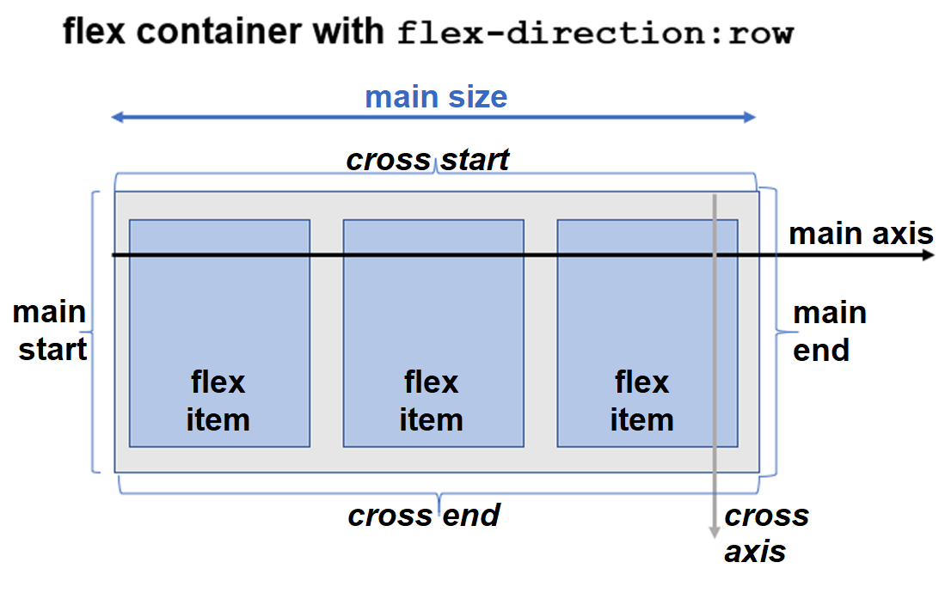
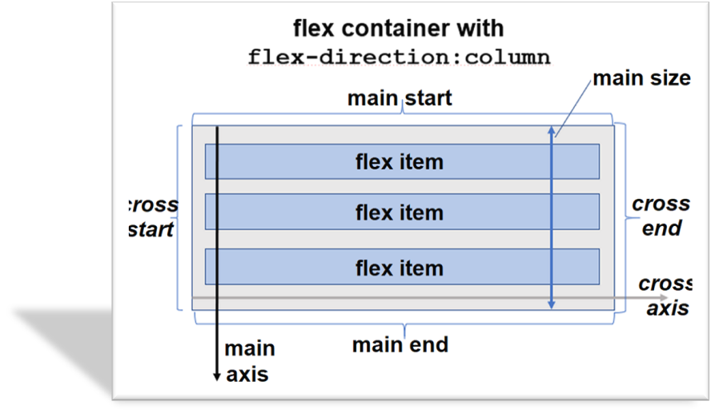
Diagram of a Flex Container
https://www.w3schools.com/css/css3_flexbox.asp

Slide 5
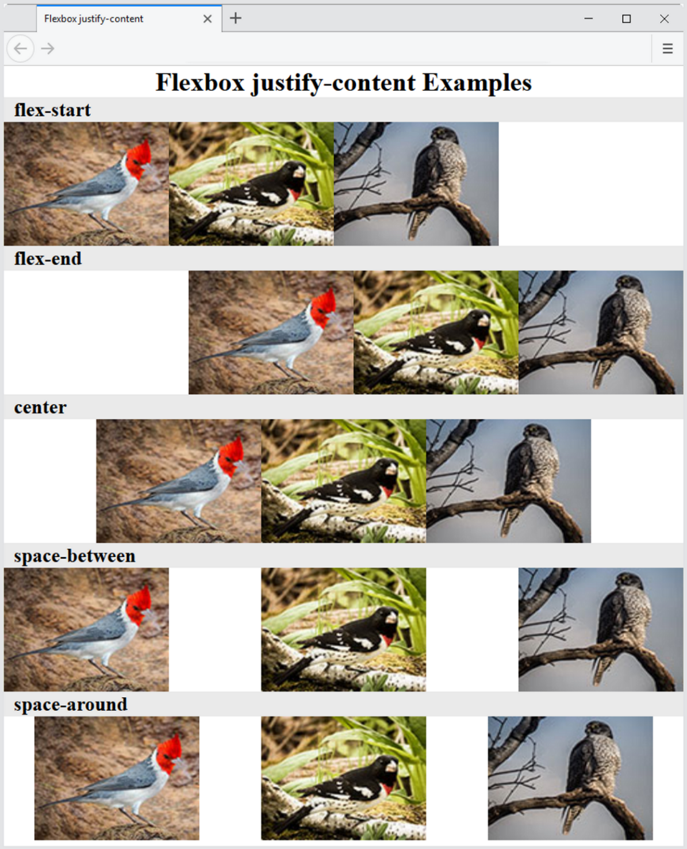
The justify-content
Property
Configures how the extra space along the main axis should be displayed

Slide 6
More flexbox Properties
The align-items Property
  Configures how the browser displays extra space along the cross-axis
The flex-flow Property
  Shorthand to configure flex-direction and flex-wrap properties
The order Property
  Causes the browser to display flex items in different order than they are coded
  Warning – this could be an accessibility issue

Slide 7
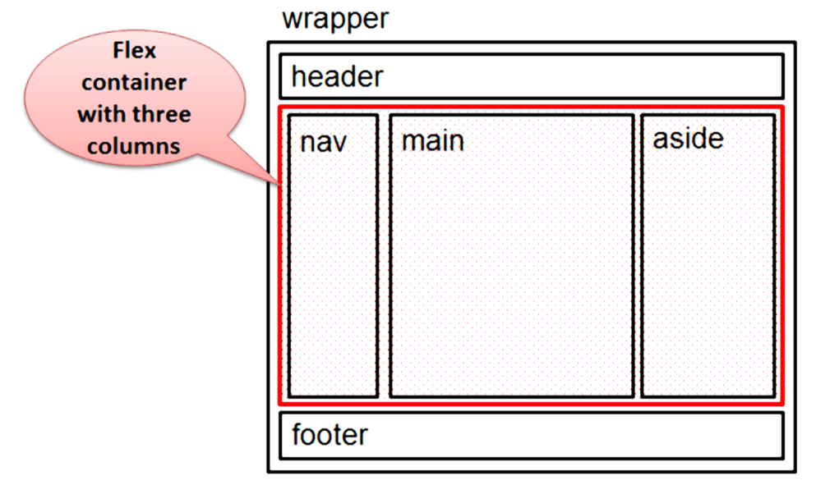
Configure Flex Items
By default flex items are flexible in size and allocated the same amount of space in the flex container
The flex property
  Customizes the size of each flex item
  Indicated the flex grow factor
  Indicates the flex shrink factor
  Can be used to indicate a proportional flexible item
      nav { flex: 1; }
      main { flex: 7; }
      aside { flex: 2; }

Slide 8
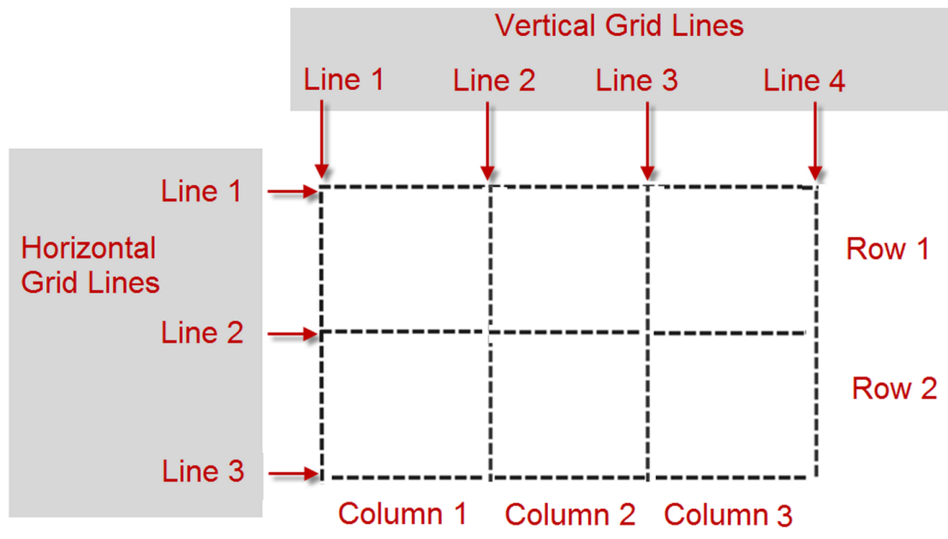
CSS Grid Layout
Purpose: Configure a two-dimensional grid-based layout
The grid can be fixed in dimension or flexible and responsive.
https://www.w3.org/TR/css-grid-1/
The display property
  Configures a grid container
  display: grid;
Grid Item -- a child element of the grid container
Grid Terms
  Grid line
  Grid row
  Grid column
  Grid track
  Grid gap
The order property

Slide 9
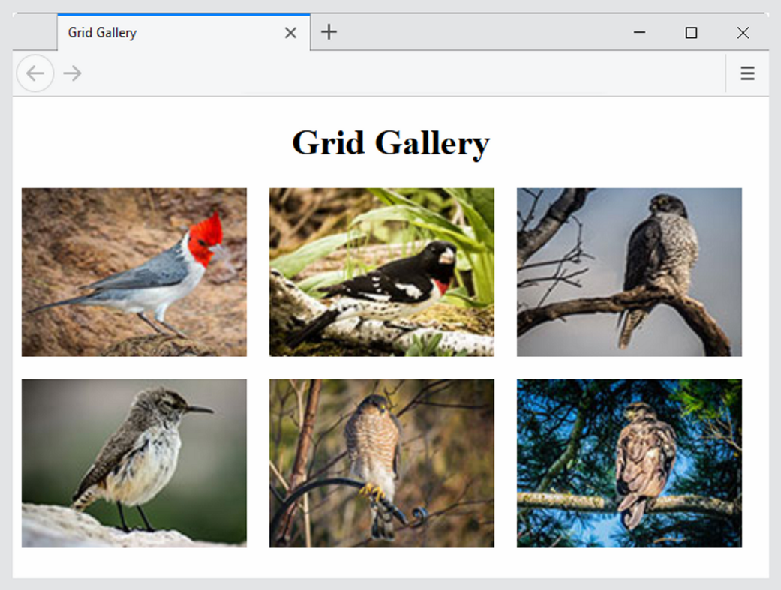
Configure Grid Columns and Grid Rows
The grid-template-columns property
The grid-template-rows property
Example:
#gallery { display: grid;
grid-template-columns: 220px 220px 220px;
grid-template-rows: 170px 170px; }

Slide 10
Grid Columns & Grid Rows,
https://www.w3.org/TR/css-grid-1/#propdef-grid-template-columns
Commonly used values for grid-template-columns and
grid-template-rows
Value | Description
numeric length unit | Configures a fixed size with a length unit such as px or em Example: 220px
numeric percentage | Configures a percentage size; Example: 20%
numeric fr unit | Configures a flex factor unit (denoted by fr) that directs the browser to allocate a fractional part of the remaining space
auto | Configures a size to hold the maximum content
minmax (min, max) | Configures a size range greater or equal to min value and less than or equal to max value. The max can be set to a flex factor.
repeat(repetition amount, format value) | Repeats the column or row the number of times specified by the repetition amount numeric value or keyword and uses the format value to configure the column or row. The auto-fill keyword indicates to repeat but stop before an overflow. Example: repeat (autofill, 250px)

Slide 11
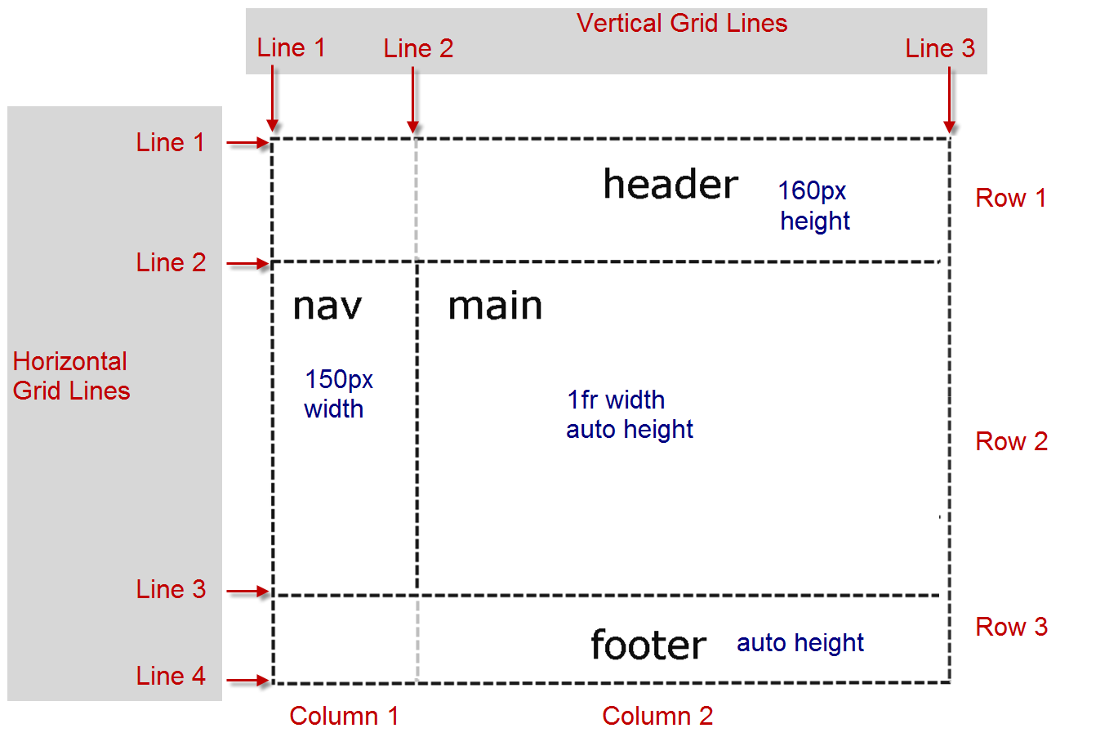
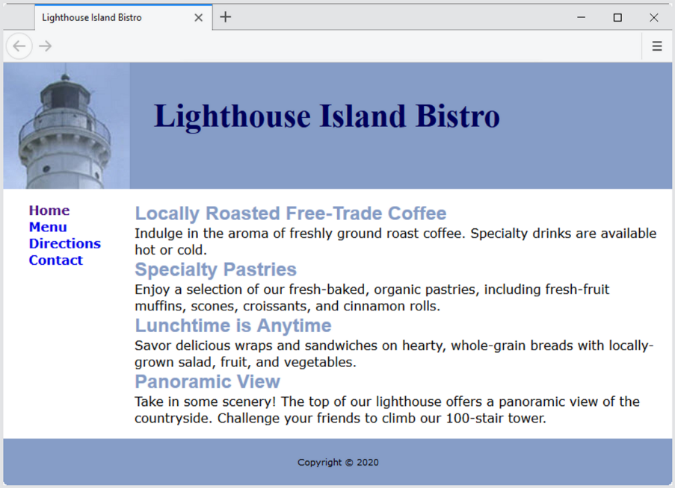
Configure Grid Items
The grid-row property
  configures the area in rows
  that is reserved for
  the item in the grid
The grid-column property
  configures the area in columns
  that is reserved for
  the item in the grid
Grid Line Numbers
  Identify the starting and ending
  line number separated
  by a / character
header { grid-row: 1 / 2; grid-column: 1 / 3; }
nav { grid-row: 2 / 3; grid-column: 1 / 2; }
main { grid-row: 2 / 3; grid-column: 2 / 3; }
footer { grid-row: 3 / 4; grid-column: 1 / 3; }
https://www.w3.org/TR/css-grid-1/#typedef-grid-row-start-grid-line

Slide 12
Progressive Enhancement with Grid
CSS Feature Query
  A feature query is a conditional that can be used to test for support of a CSS property, and if support is found, apply the specified style rules.
    @supports ( display: grid) {
    …. grid styles go here …
    }
Progressive Enhancement Strategy
  Configure web page layout with normal flow or float for browsers and devices that do not support grid
  Configure a feature query with grid layout for modern browsers

Slide 13
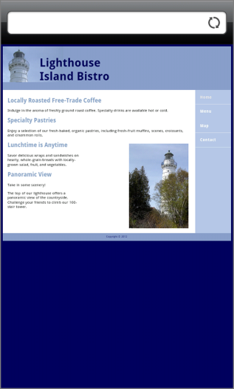
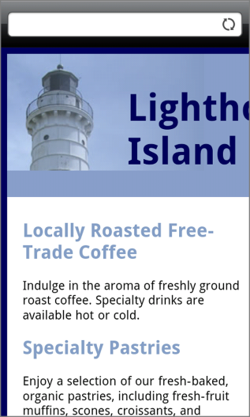
Viewport Meta Tag
Default action for most mobile devices
is to zoom out and scale the web page
Viewport Meta Tag
  Created as an Apple extension
  to configure display on mobile devices
  Configures width and
  initial scale of browser viewport
<meta name="viewport"
content="width=device-width, initial-scale=1.0">

Slide 14

Telephone & Text Message Hyperlinks
Telephone Scheme
<a href="tel:888-555-5555">Call 888-555-5555</a>
Many mobile browsers will initiate a phone call when the hyperlink is clicked.
SMS Scheme
<a href="sms:888-555-5555">Text 888-555-5555</a>
Many mobile browsers will initiate a text message to the phone number when the hyperlink is clicked.

Slide 15
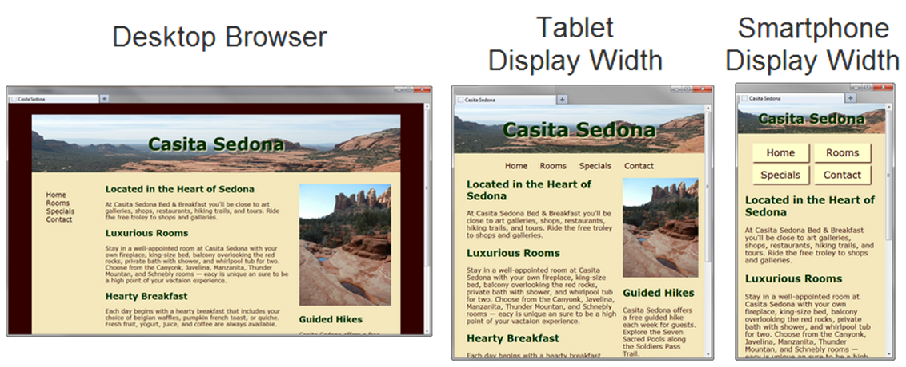
Responsive Web Design
Progressively enhancing a web page for different viewing contexts
Techniques:
  Fluid Layout
  CSS Media Queries
  Flexible Images

Slide 16
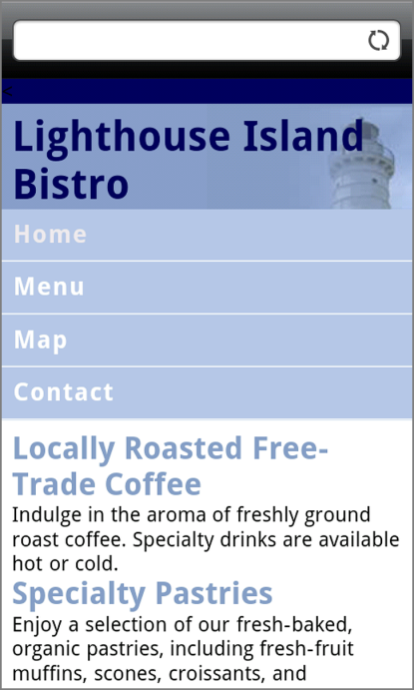
CSS3Media Queries
Media Query
  Determines the capability of the mobile
  device, such as screen resolution
  Directs the browser to styles configured
  specifically for those capabilities
Link Element Example:
<link href="lighthousemobile.css"
media="only screen and (max-device-width: 480px)">
CSS Example:
@media only screen and (max-width: 480px) {
header { background-image: url(mobile.gif);
}
}

Slide 17
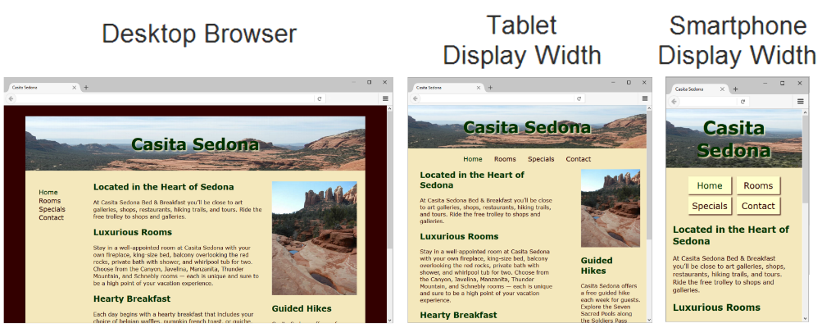
Flexible Images
Edit HTML:
remove height and width attributes
CSS:
img { max-width: 100%;
height: auto; }

Slide 18
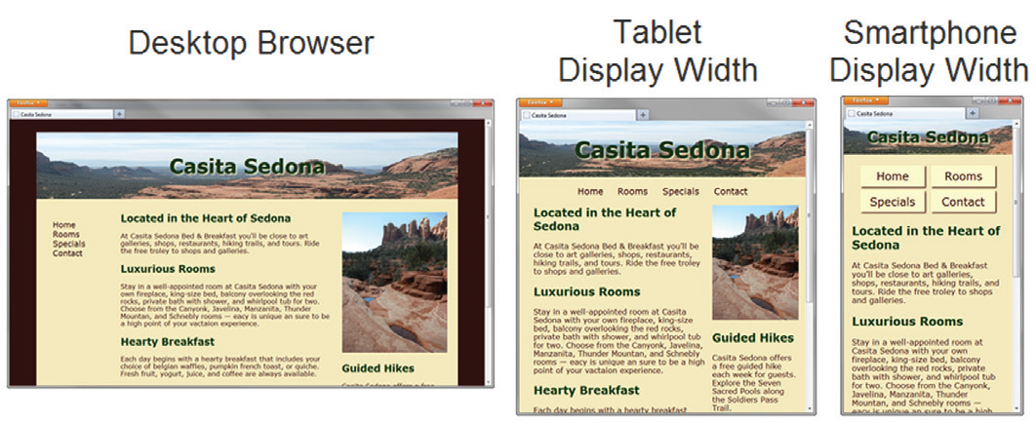
Flexible Images
Edit HTML:
remove height and width attributes
CSS:
  img { max-width: 100%;
  height: auto; }

Slide 19
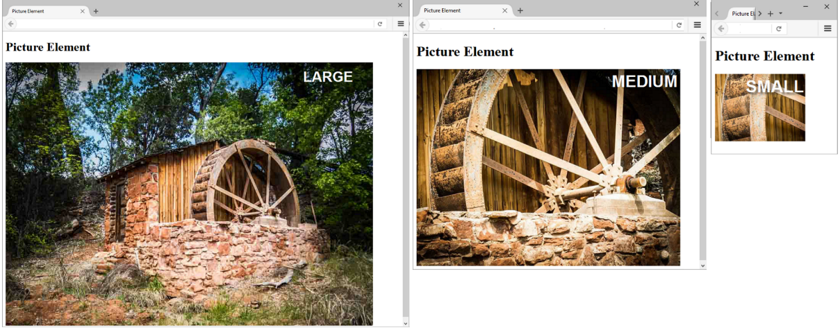
Responsive Images
HTML 5.1 Picture Element
<picture>
<source media="(min-width: 1200px)" srcset="large.jpg">
<source media="(min-width: 800px)" srcset="medium.jpg">
<source media="(min-width: 320px)" srcset="small.jpg">
<img src="fallback.jpg" alt="waterwheel">
</picture>
HTML source srcset Attribute (w3schools.com)

Slide 20
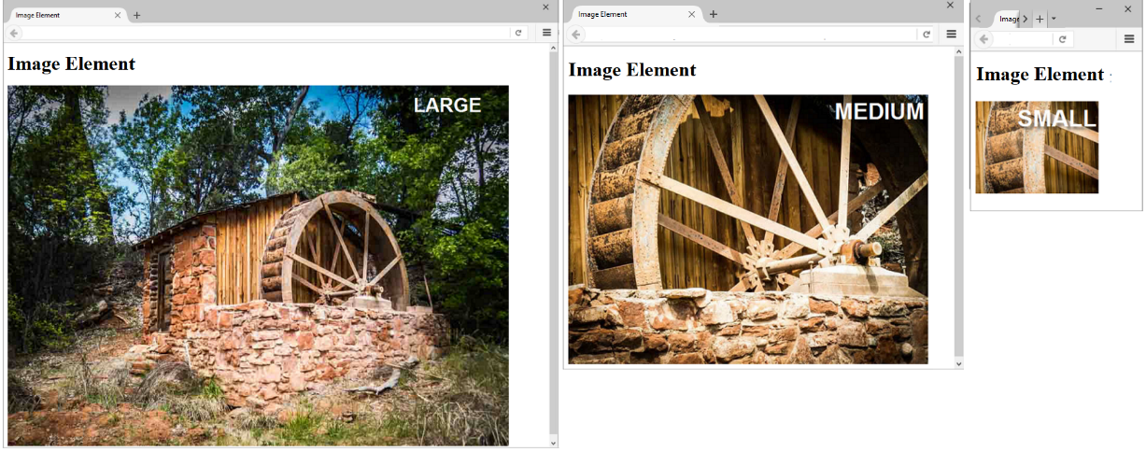
Responsive Images
HTML 5.1 sizes & srcset Attributes
<img src="fallback.jpg"
sizes="100vw"
srcset="large.jpg 1200w, medium.jpg 800w, small.jpg 320w"
alt="waterwheel">

Slide 21
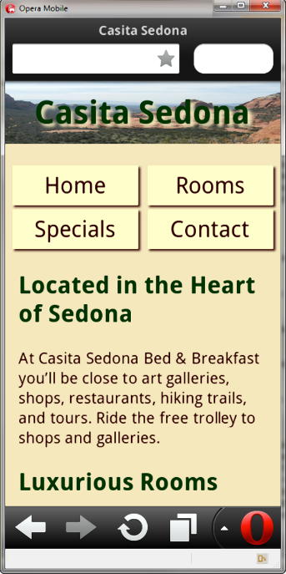
Testing Mobile Display Options
Test with a mobile device
Emulators
  Opera Mobile Emulator
  Mobilizer
  Opera Mini Simulator
  iPhone Emulator
Test with a Desktop Browser
Install an iOS or Android SDK

Slide 22
CSS Debugging Tips
Manually check syntax errors
Use W3C CSS Validator to check syntax errors
  http://jigsaw.w3.org/css-validator/
Configure temporary background colors
Configure temporary borders
Use CSS comments to find the unexpected
  /* the browser ignores this code */
  <!-– your comment or code here -->
  Main
  {
  //Background-color: #AAE455;
  }
Don’t expect your pages to look exactly the same in all browsers!
Be patient!

Slide 23
Summary
This chapter expanded your CSS and HTML skillset.
You configured web pages with CSS Flexible Box Layout (flexbox).
You configured web pages with CSS Grid Layout.
You configured web pages for mobile display using the viewport meta tag.
You applied responsive web design techniques with CSS media queries and feature queries.
You applied responsive image techniques including the picture element.
You explored techniques for testing the mobile display of a web page.

